Slide 1

Whispers of Retention : The retention gap in telecom churn – BY Processor Squad
A sophisticated multi-agent AI platform, built on UiPath Maestro, orchestrates ten specialized agents across CRM intelligence, sentiment analysis, behavioral risk assessment, and unified risk scoring to predict telecom customer churn in real time. The solution embeds an ethics-first retention framework, rigorously screening each customer against hardship and governance criteria before initiating empathetic, human-in-the-loop.

Slide 2
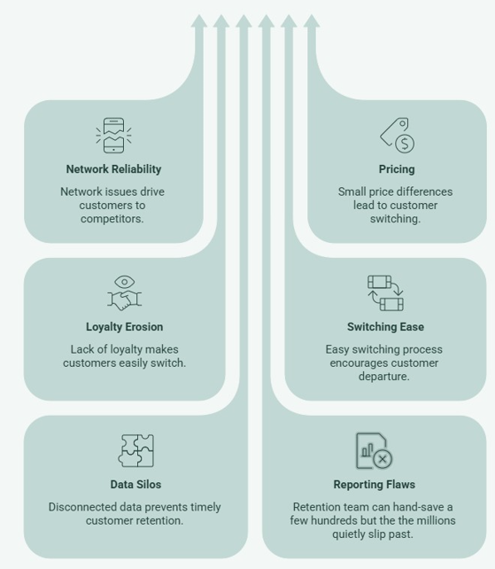
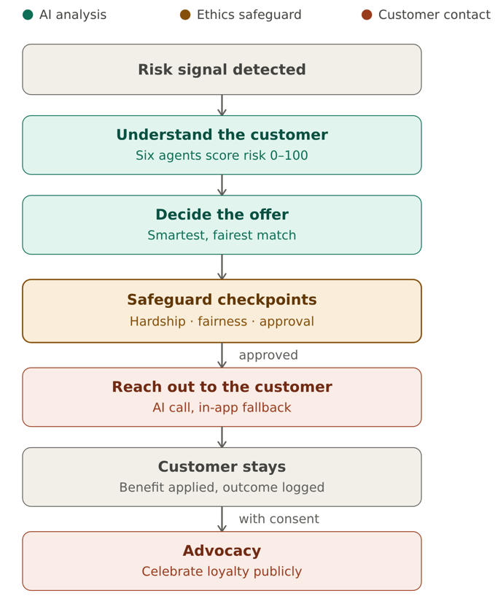
Problem statement and proposed solution
Problem
Solution
GuardianPulse AI is a multi-agent platform built on UiPath Maestro that spots telecom customers about to leave, reads their full situation with six AI agents to score churn risk, and picks the fairest retention offer for each one. Before anyone is contacted, every offer must clear three safeguards — hardship, fairness, and human approval — so the AI only proposes while a person makes the final call. Customers who stay and consent can then have their loyalty celebrated publicly.
Telecoms lose up to 50% of customers every year — they're disappearing in silence, and every dashboard you own calls them "loyal" right up to the day they're gone. With millions of subscribers, no human team can catch the warning signs in time — so the revenue walks out the back door before anyone reacts.

Slide 3
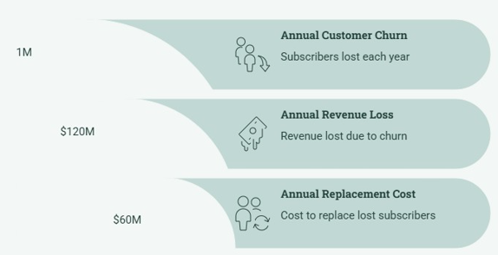
Benefits and technologies used
End-user​ | Telecom retention agents / customer-experience teams (with customers as the indirect beneficiaries).
User department​ | Customer Retention / Churn Management (Telecom Customer Experience & Revenue Assurance). (Mostly USA and EU market)
Industries​ | Telecommunications
UiPath products used​ | Maestro (BPMN orchestration), Agent Builder / Agentic AI agents, Studio Web, Orchestrator, Action Center (human-in-the-loop), Integration Service, Apps (offer review / final approval UI)
Other - integrations / APIs / technologies used​ | Twilio (outbound voice/telephony), REST APIs, Python coded agent (LangGraph).
Benefits, impact and outcomes
It bleeds money, quietly, every year (Why Telecom Customers Churn and How to Measure it? - Tridens)
Protects revenue — proactively retains high-value customers before they churn, safeguarding recurring ARPU and lifetime value instead of reacting after cancellation.
Smarter, leaner offers — right-sizes every retention offer to the individual, cutting margin waste from blanket discounts.
Scales without headcount — autonomous multi-agent pipeline handles the full customer base, freeing agents for only high-impact and hardship cases.
Loyalty into growth — empathetic human-in-the-loop outreach plus consent-based advocacy turns saved customers into public proof that attracts new ones.
Make the brand value as aspirational for more business

Slide 4
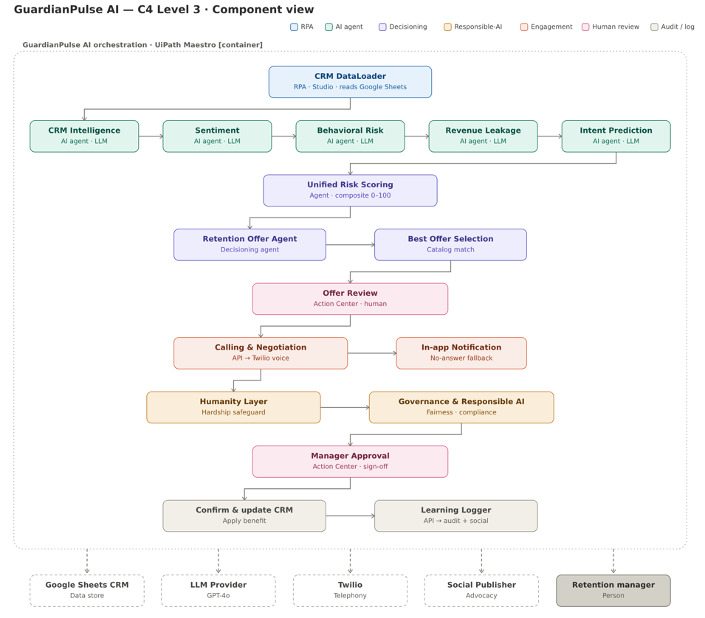
Solution architecture

